Slide 1
Business Process Engineering
Qualitative Analysis
Lecture: 08
Instructor: Salman Ahmad

Slide 2

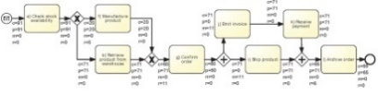
Process Analysis

Slide 3
Process Analysis Techniques
Qualitative analysis
Value-Added & Waste Analysis
Issue Register
Quantitative Analysis
Root-Cause Analysis
Pareto Analysis

Slide 4
Qualitative analysis
Issue Register & Pareto Charts
Value-Added & Waste Analysis
Root-Cause Analysis
Notes:
What should we be doing
What should we not be doing
Identify issues but talking to please and structuring the process

Slide 5

Value-added analysis
Decorticate the process into steps
Steps performed before a task
The task itself, possibly decomposed into smaller steps
Steps performed after a task, in preparation for the next task
Classify each step
Value-adding (VA)
Business value-adding (BVA)
Non-value-adding (NVA)
Notes:
Intro to value-added analysis
Two phases: first decorticate each process task into steps:
What I need before the task
The actual task (potentially a set of steps)
What I need to do after the task in preparation for the next
Then assign each step a type (VA, BVA, NVA)

Slide 6
Value-adding steps
Maximize
Produce value or satisfaction to the customer
Criteria
Is the customer willing to pay for this step?
Would the customer agree that this step is necessary to achieve their goals?
If the step is removed, would the customer perceive that the end product or service is less valuable?
Examples
Order-to-cash process: Confirm delivery date, Deliver products
University admission process: Assess application, Notify admission outcome
Notes:
VA
Required by the customer
Criteria
- Would the customer be willing to pay for them? - receiving the good
- Would he perceive they are necessary? - doing the application assessment in a university admission process (similar to determining the amount of benefit from a health insurer). This is different than the sanity check, which is required by the business (BVA) and not by the customer who thinks his application is perfectly fine and compliant with the specifications
- Would he perceive that without them there would a reduced value? - receiving a notification (the whole experience of purchasing a good would deteriorate)
However, if I consider a feedback request at the end of the process (eg after purchasing some goods) that for the customer doesn't really add value and without it his experience would not be affected. This is a business-value-adding activity, as it's necessary for the business to improve

Slide 7
Business value-adding activities
Minimize
Necessary or useful for the business to operate
Criteria
Is this step required in order to collect revenue, to improve or grow the business?
Would the business (potentially) suffer in the long-term if this step was removed?
Does it reduce risk of business losses?
Is this step required in order to comply with regulatory requirements?
Example
Order-to-cash process: Check purchase order, Check customer’s credit worthiness, Issue invoice, Collect payment, Collect customer feedback
University admission process: Verify completeness of application, Check validity of degrees, Check validity of language test results
Notes:
BVA
Not required vis-a-vis for the customer
Criteria
- Required to generate value for the business or improve the business - issuing an invoice, collecting the payment or collecting customer feedback
- Required to avoid loss in the long run or reduce the risk of incurring a loss - checking the correctness of a loan application or checking the credit history of a loan applicant
- Required for compliance (e.g. for legal or regulatory requirements) - if we don't do it we may get fined. Doing all required checks in a university admission process (application completeness, language test validity check, former degrees validity check etc
As a pattern, checks and verifications are BVA

Slide 8
Non-value-adding activities
Remove
Everything else besides VA and BVA. Activities the customer would be unwilling to pay for
Incudes
Handovers, context switches
Waiting times, delays
Rework or defect correction
Examples
Order-to-cash process: Forward PO to warehouse, Re-send confirmation, Receive rejected products
University admission process: Forward applications to committee, Receive admission results from committee
Notes:
NVA
All that is not VA or BVA
- handover and context switches (a participant switches from one case to another and requires time to get acquainted with the new case) (corresponding to Transportation or Motion in waste) part of processing time. Handover is due to the internal structure of the process, which may be totally transparent to the customer, e.g. the customer doesn’t know and couldn’t care less that the PO is received by sales and then moved to finance and warehouse. “May” because the customer may be internal themselves, like in the case of the site engineer for the equipment rental process
- waiting or delay [waiting for an object to become available, delay in the continuation of an instance because resources are not avaiable] (corresponding to Waiting in waste) NOT part of processing time
rework and defects: fixing (corresponding to Defects in waste) part of processing time
Examples
Order to cash:
- Forwarding PO to warehouse
- Resenting order confirmation (as the first one was incorrect)
- Waiting for a confirmation to arrive from warehouse
- Getting the product back because it was rejected by the customer
University admission process:
- Forwarding application from student office to evaluation committee
- Receiving application back from evaluation committee
- Rectifying an evaluation result because it was incorrect (e,g, the committee missed a certain degree that the student actually obtained)
(Processing time: actual time measured for VA, BVA and NVA except the waiting component)
(Cycle time: processing time + waiting component of NVA)
(Theoretical cycle time: optimal processing time, ie minimum possible VA + BVA and without any NVA)
(Cycle time efficiency: theoretical cycle time / cycle time)

Slide 9
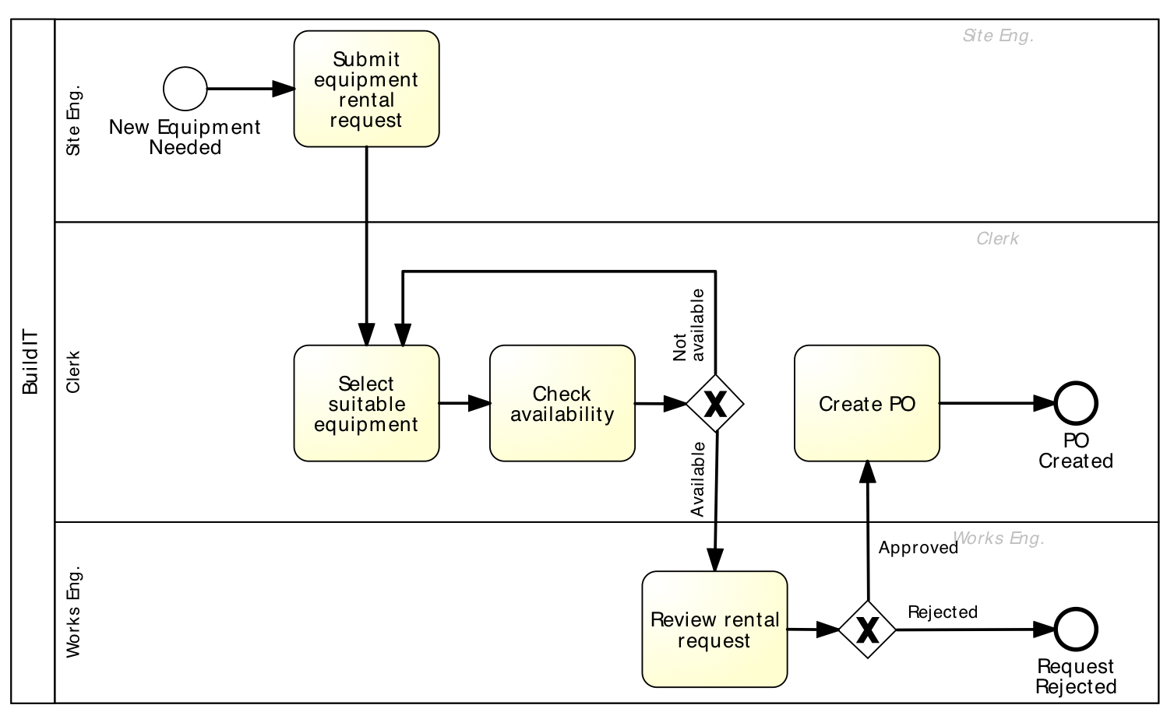
Extract of Equipment Rental Process
- Fill request (VA)
- Send request to clerk (NVA)
- Fill request
- Send request to clerk
- Check equipment availability (VA) – 1st time
- Record recommended equipment (BVA)
- Forward request to works engineer (NVA)
- Check equipment availability - Record recommended equipment - Forward request to works engineer
- Produce PO
- Submit PO to supplier
- Open and read request - Select suitable equipment
- Produce PO (BVA)
- Submit PO to supplier (VA)
- Open and read request (NVA)
- Select suitable equipment (VA) – 1st time
- Open and examine request (BVA)
- Communicate issues (BVA)
- Forward request back to clerk (NVA)
- Open and examine request
- Communicate issues
- Forward request back to clerk
Notes:
Purchasing and maintaining equipment costs more than renting appropriate equipment. The advantage is that you always have new generation equipment that has been maintained
sutiable equipment = adequate equipment, based on the needs of the construction engineer
site engineer = construction engineer who is on site
clerk is found in the warehouse for example, together with the works engineer
works engineer = engineer responsible for the works

Slide 10
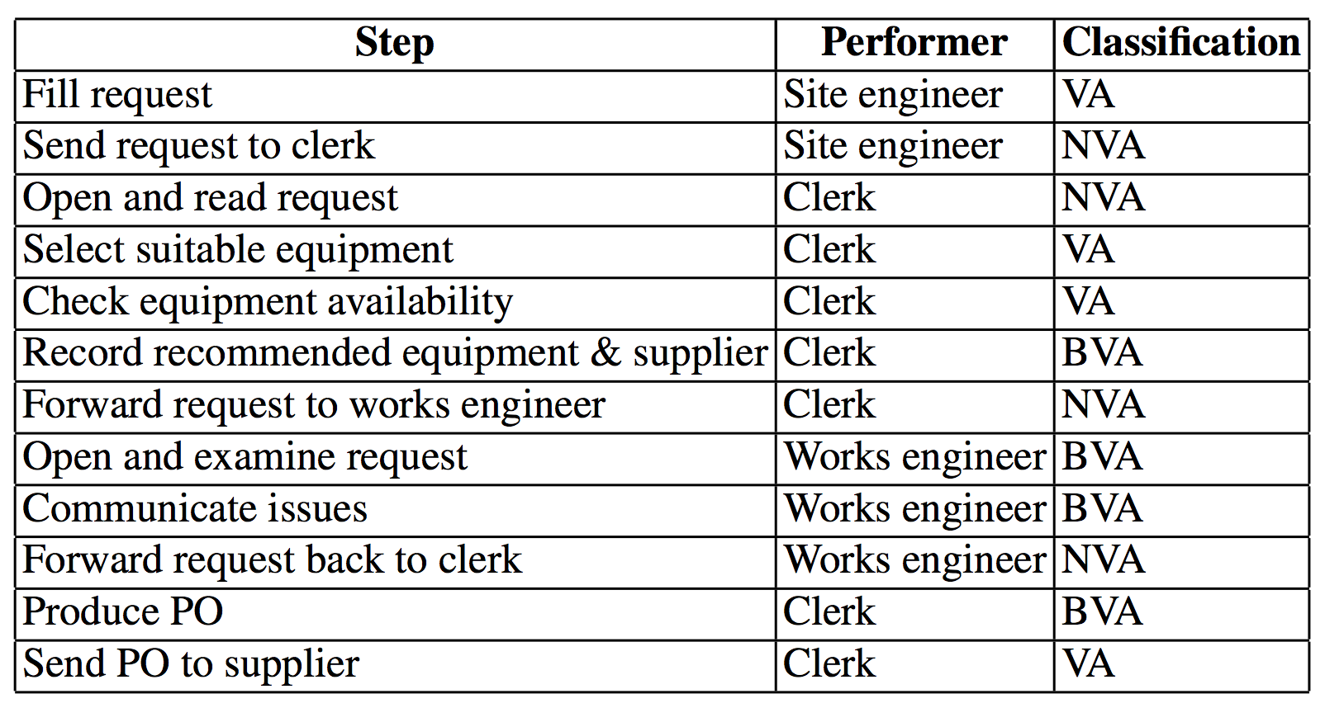
Equipment Rental Process – VA Analysis

Slide 11
Waste analysis
“All we are doing is looking at the time line, from the moment the customer gives us an order to the point when we collect the cash.
And we are reducing the time line by reducing the non-value-adding wastes”
Taiichi Ohno, Toyota
Notes:
Now let’s look at value adding from negative (or waste) perspective. This is from a negative way, as opposed to value-added analysis which is from a positive way.
Muda = waste in Japanese
Taiichi Ohno looks at the timeline, meaning the end-to-end process, even if not called so, the principle is there

Slide 12
Seven sources of waste
Move
Motion
Hold
Waiting
Over-do
Over-Processing
Over-Production
Transportation
Inventory
Defects
Notes:
Unnecessary transportation

Slide 13
Move

Slide 14
Transportation
Send or receive materials or documents (incl. electronic) taken as input or output by the process activities
Example
University admission process: to apply for admission at a university, students fill in an online form. When a student submits the online form, a PDF document is generated. The student is requested to download it, sign it, and send it by post together with the required documents:
1. Certified copies of degree and academic transcripts
2. Results of language test
3. CV When the documents arrive at the admissions office, an officer checks their completeness. If a document is missing, an e-mail is sent to the student. The student has to send the missing documents by e-mail or post depending on document type.
Notes:
WASTE - MOVE
Unnecessary transportation = of business objects
E.g. In the context of a Uni admission process, the student has to print the PDFs form, sign it, attach other documents and send it by post. This is similar to ACI PRA with the new ownership certificate that still has to be printed and signed physically. This Is unnecessary transportation. Again, in the Uni admission process, the sending of the application by post is unnecessary transportation because this could simply be done via email.
An other example is when the scanned copies of documents are not readable or some documents are missing and the Uni admin office has to get back to the student.
the university process is an example of a so-called “chatty” process
It doesn’t mean that in analysis we want to remove all these transportations, but just identifying which ones are indeed unnecessary
Corresponds to handover of work in VA analysis

Slide 15
Motion
Motion of resources internally within the process
Common in manufacturing processes, less common in service processes
Examples
Application-to-approval process: a process worker moves around the organization to collect signatures
Notes:
Motion = of process participants and customer (ie of process resources) that move together with business objects (eg a form) or passive resources (e.g. Equipment). The focus though is on physical movements of people
E.g. In a vehicle inspection process the mechanic has to move around different bays with the inspection form and sometimes also with equipment. In a travel requisition form, a worker has to move form one desk to another to obtain the required approvals, e.g. Approval for expenses, approval for travel plan, approval for business replacement plan etc

Slide 16
Hold

Slide 17
Inventory
Materials inventory
Work-in-process (WIP)
Example
University admission process: About 3000 applications are handled concurrently
Vehicle inspection process: when a vehicle does not pass the first inspection, it is sent back for adjustments and left in a pending status. At a given point in time, about 100 vehicles are in the “pending” status across all inspection stations
Notes:
WASTE - HOLD
Inventory:
materials inventory (raw materials or produced goods that are stocked more than required) and
WIP (number of open/pending cases at a given point in time, ie number of cases started but not yet completed). WIP = lambda (arrival rate) * CT. If we want to keep the WIP the same while the arrival rate increases, we need to decrease CT.
Materials inventory:
E.g. Italian hospitals keeping excessive levels of medicines in stock knowing they won't be able to use them before the expiry date. This is a loss
WIP:
Eg vehicle inspection process: there are 100 bays employed at a given point in time, meaning that these are cases that's are not yet completed and so cannot lead to value for the company. Especially if the cases get stuck in delays due to rectification required by the customer in order to pass a given test
In a university admission process, applications are assessed by the committee in batches, I.e. All at once for a given entry term, rather than straight-through-processing in the Toyota philosophy (the idea behind automation, I.e. that each case is processed straightaway without synching with other cases in order to get to the outcome which generates value). At a university, during the admission period, there might be as a high as 3000 applications in a pending state, waiting to be assessed. Note that clearly certain processes do require batching so this may be reduced but not necessarily eliminated as in the case of the university, where one would have more waste in processing each application one by one, in fact it’s simply not possible because the committee has to deliberate collectively. What can be done, however, is to simplify the job of the committee by providing as much information in advance as possible and doing as many checks as possible beforehand, e.g. Via automated activities

Slide 18
Waiting
Task waiting for materials or input data
Task waiting for a resource
Resource waiting for work (resource idleness)
Examples
Application-to-Approval process: Request waiting for approver
University admission process: Incomplete application waiting for additional documents; batch of applications waiting for committee to meet
Vehicle inspection process: A technician at a base of the inspection station waiting for the next vehicle
Notes:
Waiting
Task waiting for input object or resource
Resource in idle time waiting to work a task
E.g vehicle inspection, the technician waits for the next vehicle to assess
In approval process, the second approval step is waiting for the approved to be available
In the Uni admission process, some applications are incomplete, an email is sent to the student and now wait for the student to send the missing documents, that waiting (task waiting for input documents) is a type of Waiting waste. Similarly, when we batch applications for assessment, these applications are waiting for the committee to meet. Specifically, it's the task of doing the assessment that is waiting for the resource (the committee) even if all applications are ready.

Slide 19
Over-do

Slide 20
Defects
Correcting or compensating for a defect or error
Rework loops
Examples
Travel approval process: Request sent back to requestor for revision
University admission process: Application sent back to applicant for modification; request needs to be re-assessed later due to incomplete information
Vehicle inspection process: A vehicle needs to come back to a station due to an omission
Notes:
Correcting a defect/an error = doesn’t imply the repetition of the task, but typically of part of a task, e.g. fixing an application because it’s incorrect, doesn’t mean redoing the application from scratch
Compensating for negative effects due to defects or errors = implies to perform compensating actions (like in BPMN a compensation activity), e.g. cancel a booking, repaying a customer because the product was not the right one, or because it was damaged. These are extra activities only done due to these exceptions
Rework loops = repeating a task entirely, e.g. sending a notification because it wasn’t received the first time, or searching a catalogue because the first product found was actually not available etc.
Difference between defect and error:
defect = typical of manufacturing processes, where there is a construction issue in the product (e.g. front axis of Toyota has to be recalled – defect correction)
error = typical of service processes, where some (human) error was made when preparing a document (e.g. a travel application has the wrong computation of allowances)
WASTE - OVERDO
Defect:
Correct or compensate for a defect or error (e.g. An iPad was shipped with a defect and we have to fix that defect by replacing the wireless antenna)
Rework: we have to redo something from scratch because it was not good enough (e.g. A custom-made violin needs to be scrapped and remade from scratch because it didn't come up good in terms of sound quality, or a notification to a customer needs to be sent again because it did not arrive the first time)
E.g. Vehicle inspection process: there was an omission in the vehicle assessment and now it has to be reassessed so it's call back to the service bay. This is fixing the omission, but the inspection doesn't need to be repeated. For example, they forgot to do a particular check and only realized later. Or Toyota recalling certain vehicles because they have structural problems that may put the passengers at risk. This is fixing for a construction defect
Travel approval: the application is not approved as the period of travel is too long, or it doesn’t have a proper business replacement plan, hence the application is returned to the requestor who has to amend it (the task is only partially redone, not entirely, so it’s a case of error correction)
In the Uni admission process, the application is sent back because of missing information, or the candidate is called for clarifications, upon which the application needs to be assessed again. This is rework. The assessment has to be done again from scratch

Slide 21
Over-processing
Tasks performed unnecessarily given the outcome of the process
Unnecessary perfectionism
Examples
Travel approval process: 10% of approvals are trivially rejected at the end of the process due to lack of budget
University admission process: Officers spend time verifying the authenticity of degrees, transcripts and language test results. In 1% of cases, these verifications uncover issues. Verified applications are sent to the admissions committee. The admission committee accepts 20% of the applications it receives
Vehicle inspection process: technicians take time to measure vehicle emissions with higher accuracy than required, only to find that the vehicle clearly does not fulfill the required emission levels
Notes:
Over-processing
- doing tasks with excessive quality, e.g. Perfectionism, I.e. More than required. For example, in a vehicle inspection process, taking too much time to check emissions when the vehicle will clearly not pass the emissions test, or when producing goods, setting specifications (tolerance levels) much tighter than required. Note that this could be actually a differentiating factor, e.g. In Apple with extreme high level design, or in Vino Libero, where the levels of sulfites in the wine is well below the threshold allowed by the law
- Doing more tasks than required, given the outcome of the case
E.g (for doing tasks when the outcome will be rejected). For example, in a Uni admission process, only 1% of the applications are rejected because of unauthentic certificates or documents. However, admin staff loses a lot of time checking very carefully the authenticity of each single document, when the admission committee will rejects 80% of the applications because the candidate is simply not suitable. Hence, all these documents checks in a very accurate way are an example of overprocessing.
We will see in redesign that we have to strike a trade off between how many checks to do and the need to streamline the process, and if they are mandatory for compliance purposes and thus cannot be avoided, we need evaluate the possibility of repositioning (resequencing them) so that the checks with highest knock out are done at the beginning, in order to avoid overprocessing. In the Uni example, why doesn't the committee first meet to assess the candidate eligibility and only then the authenticity checks are done for the eligible candidates only?

Slide 22
Over-production
Unnecessary process instances are performed, producing outcomes that do not add value upon completion
Examples
Quote-to-cash process: In 50% of cases, issued quotes do not lead to an order
Travel approval process: In 5% of cases, travel requests are approved but the travel is cancelled
University admission process: About 3000 applications are submitted, but only 600 are considered eligible after assessment
Notes:
Over-production
Entire process instances (rather than tasks) wasted because they do not produce outcomes that are of value upon completion. Originally it comes for producing more than required.
Sometimes, the process instance in which there is overprocessing, is a case of overproduction. Example: uni admission process = half of the process is over-processing (i.e. after the initial checks that must be done, if eventually the final check, that of the committee, will lead to a reject of the application). This is a case of over-produced instance with part of over-processing within (i.e. until the final knock out check). An example of over-produced instance without over-processing (or better, where the whole instance is over-processed and not only part of it) is the quote-to-order process, for those quotes where the order-to-cash process will never start.
Note: there might be cases of over-processing which do not lead to over-production, e.g. only a branch of the process has to be canceled because it was unnecessary, but the process instance eventually leads to a positive outcome. For example, a subprocess for proposing an insurance policy to go along a loan origination process does not lead to the insurance policy being sold, though the loan is eventually sold. The subprocess is overprocessing but the entire process instance is not overproduction.
E.g. In the Uni admission process, 80% of applications are rejected, I.e. 2400. The process for assessing each of these 2400 applications is a case of overprocessing. How can we avoid that? For example by better informing our customers of the eligibility requirements in order to avoid submitting applications in the first place. So, with the instance we can eliminate overprocessing by placing the strongest knock out checks at the beginning, but if we better communicate our requirements to the prospective students, then we can avoid to process an application altogether, hence reducing overproduction which is better not than reducing overprocessing.
In a quote-to-cash chain, the quote-to-order process leads to queries that in the 50% of cases do not lead to an order. So how do we avoid this overprocessing? For example by working on improving the conversion rate between quotes and orders, or by avoiding generating quotes which are likely to be rejected.
In a travel approval process, 5% of approved applications are cancelled by the applicant in the end, Ie after having being approved) through another process, a travel cancellation process). If we better understand the common causes for cancellation we can avoid or defer the approval of a given travel application if it's likely this is going to be canceled anyway.

Slide 23
Equipment rental process: wastes
Send request to clerk (Transportation)
Defect
Forward request to
works engineer (Transportation)
Forward request back to clerk (Transportation)
Over-processing
Notes:
Over-processing: clerk finds available equipment and rental request is rejected by works engineer
Considering the wastes identified in the above process, we can make a few generalizations:
The sending, receiving and handover of internal documents is a common source of transportation waste.
Rework loops in a process often represent waste, in this case, defect waste.
Waiting time between two activities is waste. So when possible and practical, we should combine tightly related activities. For example, selecting and checking of equipment should occur in the same activity to help minimize waste.
In this process, further types of waste could include:
Inventory: the equipment is kept longer than needed.
Waiting: for the availability and approval of the works engineer.
Defect: selected equipment not available, alternative equipment sought.
Defect: incorrect equipment delivered and returned to supplier
Over-processing: the fulfilled request is rejected by the site engineer because the equipment is no longer needed (this is an interruption during the execution of the process). If it happens at the end of the process, i.e. once it has been completed, then it’s a case of over-production.
Over-processing: equipment is found by clerk but then canceled by works engineer
Over-production: the equipment is rented but not used, or returned because not the correct one.

Slide 24
Equipment rental process: wastes
Transportation
Site engineer sends request to clerk
Clerk forwards to works engineer
Works engineer sends back to clerk
Inventory
Equipment kept longer than needed
Waiting
Waiting for availability of works engineer to approve
Notes:
Here’s a complete list of wastes
Waiting
- the clerk waits for the works engineering to approve the request before creating the PO, i.e. from the moment the availability has been checked to the moment the PO is created

Slide 25
Equipment rental process: wastes
Defect
Selected equipment not available, alternative equipment sought
Incorrect equipment delivered and returned to supplier
Over-processing
Rental requests being approved and then canceled by site engineer because no longer needed
Over-production
Equipment being rented and not used at all by site engineer
Clerk finds available equipment and rental request is rejected by works engineer
Equipment returned by site engineer because is incorrect

Slide 26

Issue register
Purpose: to maintain, organize and prioritize perceived weaknesses of the process (issues)
Sources of issues:
Input to the BPM project
Collected during process discovery (e.g. during modelling workshops)
Collected via stakeholder analysis
Customers
Process participants (workers)
Process owner / managers
Subcontractors, business partners
Notes:
We’ve looked at value adding from both a positive and a negative (or waste) perspective. We’ll now continue to consider other qualitative techniques in process analysis.
Issue register
Organize, maintain and priorities issues
Sources for issues:
- Some issues may have already been identified before the BPM project starts, e.g. they are known issues identified via a previous project
- others are collected as part of ongoing process improvement actions, e.g. via continuous customer feedback collection, or process participants are encouraged to collect issues.
- Another source is process discovery, and when we conduct interviews or workshops we get to know about issues. For example, we have seen than loops are indicators for rework and defects correction, while sequence flows between lanes and messages between pools are indicators of transportation, motion and waiting wastes.
- Clearly, the last input to identifying issues is via value-added analysis and waste analysis as we have just seen

Slide 27
Issue register structure
Can take the form of a table with:
Issue identifier
Short name
Description
Assumptions
Impact: Qualitative and Quantitative
Possible improvement actions
Larger process improvement projects may require issue trackers
Notes:
Components:
- ID
- name
- description
- qualitative impact
- quantitative impact
- assumptions (required to compute quantitative impact)
- (proposed changes)
Issue tracker is a software tool used in complex BPM projects (e.g. Atlassian JIRA)

Slide 28
Issue example
Issue name
Equipment kept longer than needed
Description
Site engineers keep rented equipment longer than needed by asking for deadline extensions to the supplier
Data and hypotheses
3000 pieces of equipment rented p.a. In 10% of cases, equipment is kept two days more than needed Average rental cost is 100 per day
Quantitative impact
0.1 × 3000 × 2 × 100 = 60,000 p.a

Slide 29
Issue Register Example
Equipment rental process
Name | Explanation | Data / Hypotheses | Qualitative Impact | Quantitative Impact
Equipment kept longer than needed | Site engineers keep equipment longer than needed via deadline extensions | 3000 pieces of equipment rented p.a. In 10% of cases, equipment kept two days longer than needed. Rental cost is 100 per day |  | 0.1 × 3000 × 2 × EUR 100 = EUR 60000 p.a.
Wrong equipment delivered | Site engineers reject delivered equipment due to non-conformance to their specifications | 3000 pieces of equipment rented p.a. 5% of them are rejected due to an internal mistake For each equipment rejected due to an internal mistake, BuildIT is billed EUR 100. | Disrupted schedules. Employees stress and frustration | 3000 × 0.05 × EUR 100 = EUR 15000 p.a.
Late payment fees | Late payment fees incurred because invoices are not paid by their due date | 3000 pieces of equipment rented p.a. Average rental time is 4 days. Rental cost is EUR 100 per day. Each rental leads to one invoice. About 10% of invoices are paid late. Penalty for late payment is 2%. | Poor reputation with suppliers | 0.1 × 3000 × 4 × EUR 100 × 0.02 = EUR 2400 p.a.
Notes:
i.e. the company loses EUR60 000 each year due to this issue
i.e. the company loses EUR15 000 each year due to this issue
i.e. the company loses EUR2400 each year due to this issue
---
RELATION TO WASTE
Issue 1: delays: supplier waiting for equipment to get back
Issue 2: over-production: the whole equipment request process instance has to be repeated
Issue 3: delays: supplier waiting for money to get back

Slide 30
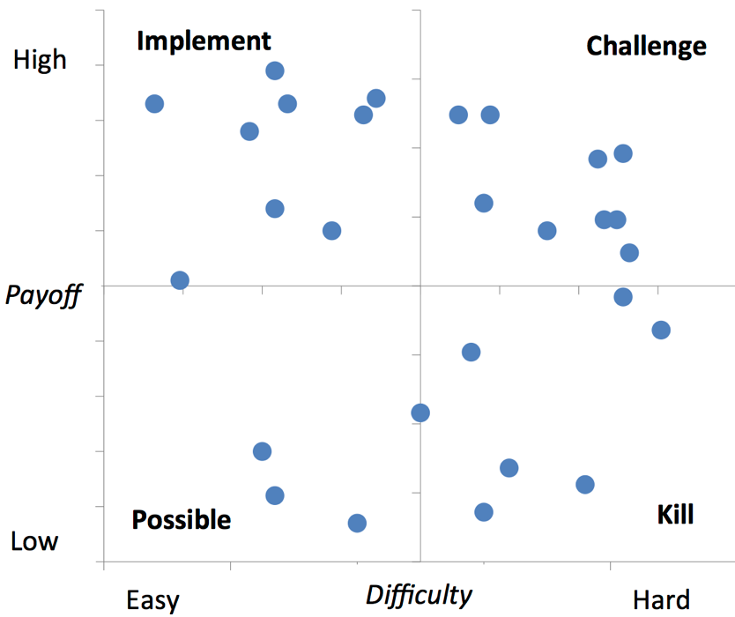
Two-Dimensional Prioritization: PICK Chart

Slide 31
Pareto chart
Useful to prioritize a collection of issues
Bar chart where the height of the bar denotes the impact of each issue
Bars sorted by impact
Superposed curve of cumulative percentage impact
Notes:
Pareto analysis is used to priorities issues. This will help us invest our efforts in redesign only on certain issues.

Slide 32
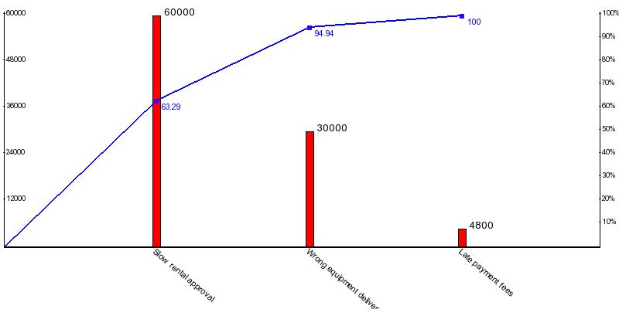
Pareto chart example
Notes:
NOTE: redo as it doesn’t correspond to the issue register: 60K, 15K, 2.4K
1) Define the effect to be analyze and the measure for this effect, e.g.:
• Financial loss for the customer or for the business.
• Time loss by the customer or by the process participants.
• Number of occurrences of a negative outcome, such as number of unsatisfied customers due to errors made when handling their case.
2. Identify all relevant issues that contribute to the effect to be analyzed.
3. Quantify each issue according to the chosen measure. This step can be done on the basis of the issue register, in particular, the quantitative impact column of the
register.
4. Sort the issues according to the chosen measure (from highest to lowest impact)
and draw a so-called Pareto chart. A Pareto chart consists of two components:
a. A bar chart where each bar corresponds to an issue and the height of the bar
is proportional to the impact of the issue or factor.
b. A curve that plots the cumulative percentage impact of the issues. For exam-
ple, if the issue with the highest impact is responsible for 40 % of the impact, this curve will have a point with a y-coordinate of 0.4 and an x-coordinate positioned so as to coincide with the first bar in the bar chart.

Slide 33
Root-cause analysis
Why-why diagram
Factors
Issue
Cause-effect
diagram
Notes:
Root cause analysis
We want to analyze each issue, once we have identified them, in order to find out the contributing factors. We do this typically via workshop (brainstorming) sessions. Nowadays process mining can be used for this, in order to be more comprehensive and remove subjectivity
Why-why diagrams: from issue working backwards towards a factor.
Cause-effect (Fishbone) diagrams: we try to find out the factors, in a forward manner, that contribute to an issue. We still start from an issue, but instead of working backwards, we use a framework to pinpoint the factors.

Slide 34
Why-why diagram
Five levels of nesting - “Five Why’s”
Notes:
The folklore has it that we need to go down 5 levels on average to get to the bottom of the problem

Slide 35
Why-why diagram example
Site engineer keeps equipment longer than needed
Site engineer fears equipment will not be available later when needed
Time between request and delivery too long
Excessive time spent in finding suitable equipment and approving the request
Time spent waiting for works engineer to check request
Time spent by clerk contacting possibly multiple suppliers sequentially
Notes:
1. Site engineers keep equipment longer, why?
2. Site engineer fears that equipment will not be available later when needed, why?
3. time between request and delivery too long, why?
4. excessive time spent in ﬁnding suitable equipment and approving the request, why?
5. time spent by clerk contacting possibly multiple suppliers sequentially
5. time spent waiting for works engineer to check the requests.

Slide 36
Cause-effect (Fishbone) diagram

Slide 37
Categories of causes: Six Ms
Machine: factors stemming from technology used
Lack of suitable functionality in the supporting software applications
Poor User Interface (UI) design
Lack of integration between systems
Method: factors stemming from the way the process is designed, understood or performed
Unclear assignments of responsibilities
Unclear instructions
Insufficient training
Lack of timely communication
Material: factors stemming from input materials or data
Missing, incorrect or outdated data

Slide 38
Categories of causes: Six Ms
Man: factors stemming from wrong assessments or incorrect performance of steps attributable to:
Lack of training and clear instructions
Lack of motivation
Too high demands towards process workers
Measurement: factors stemming from reliance on:
Inaccurate estimations
Miscalculations
Milieu: factors outside the scope of the process
Delays caused because of unresponsive external actors
Sudden increases of workload due to special circumstances

Slide 39
Cause-effect diagram example

Slide 40
Summary
Segregate value-adding, business value-adding and non-value-adding steps
Identify waste
Collect and systematically organize issues, assess their impact
Analyze root causes of issues

Slide 41
Chapter 6 - Fundamentals of Business Process Management
Marlon Dumas, Marcello La Rosa, Jan Mendling, Hajo A. Reijers
Springer 2018

